Slide 1
MetalLb
Reference:
https://www.redhat.com/en/blog/advanced-metallb-configuration
https://docs.openshift.com/container-platform/4.14/networking/metallb/about-metallb.html

Slide 2
MetalLB is valuable
  Bare-metal cluster, or an infrastructure that is like bare metal
  Fault-tolerant access to an application through an external IP address.
Ensure that network traffic for the external IP address is routed from clients to the host network for the cluster.
MetalLB operates in two modes
  Layer 2 by using Address Resolution Protocol (ARP)
  Layer 3 by using Border Gateway Protocol (BGP)
Service Type: LoadBalancer
  A service of type LoadBalancer requires two things:
    A virtual IP that can be used to reach the service
    A way to advertise the IP address, so that the traffic directed to it can reach the nodes

Slide 3
MetalLB Operator
Namespace: metallb-system
Custom Resources
  MetalLB
    Main instance that the MetalLB operator deploys.
    Operator only supports a single instance of the custom resource.
  IPAddressPool
    Range of IP addresses that MetalLB can allocate to the load balancer services.
    L2Advertisement
      Advertises an IP coming from an IPAddressPool using the L2 protocol.

Slide 4
BGPPeer
  Identifies the BGP router for MetalLB to communicate with, the AS number of the router, the AS number for MetalLB, and customizations for route advertisement.
  MetalLB advertises the routes for service load-balancer IP addresses to one or more BGP peers.
BFDProfile
  Configures Bidirectional Forwarding Detection (BFD) for a BGP peer.
  BFD provides faster path failure detection than BGP alone provides.
BGPAdvertisement
  Advertises an IP coming from an IPAddressPool using the BGP protocol.

Slide 5
MetalLB software components
Controller
  Manages the allocation of IP addresses.
Speaker
  Announces routes to the external network
  Daemon set .
  Can limit by specifying a node selector in the MetalLB custom resource at start

Slide 6
LAYER 2 MODE WORKFLOW
Step 1: Service Creation
  Kubernetes service of type LoadBalancer is created.
Step 2: Controller Action
  MetalLB Controller detects the creation and assigns an IP address from the configured pool.
Step 3: ARP Announcement
  Speaker pod on one node associated with the service sends ARP announcements for the allocated IP address.
  Speaker pod that announces the external IP address must be on the same node as an endpoint for the service and the endpoint must be in the Ready condition
Step 4: Network Traffic Handling
  Switches in the network learn the MAC address associated with the IP via ARP.
  Direct traffic to the appropriate node running the service.

Slide 7
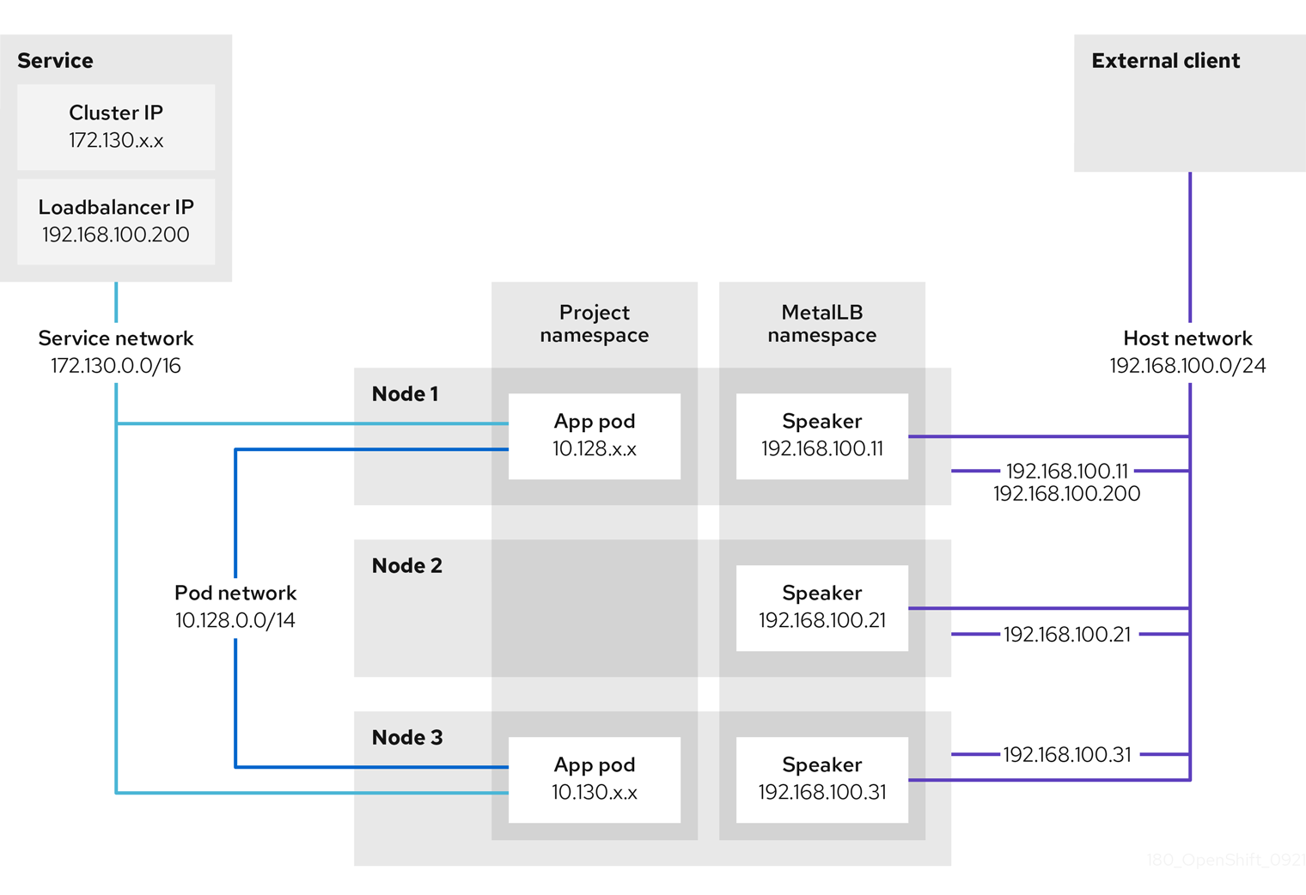

Slide 8
LAYER 3 MODE WORKFLOW
Step 1: Service Creation
  Kubernetes service of type LoadBalancer is created.
Step 2: Controller Action
  MetalLB Controller detects the creation and selects an IP address from the configured pool.
Step 3: BGP Announcement
  By default each speaker pod advertises the load balancer IP address for a service to each BGP peer.
Step 4: Network Traffic Handling
  Upstream routers learn the routes to the IP address via BGP announcements.
  When a router receives traffic for the load balancer IP address, the router picks one of the nodes with a speaker pod that advertised the IP address.
  Router sends the traffic to that node.Service proxy distribute the traffic to all pods.
  Load balancing

Slide 9
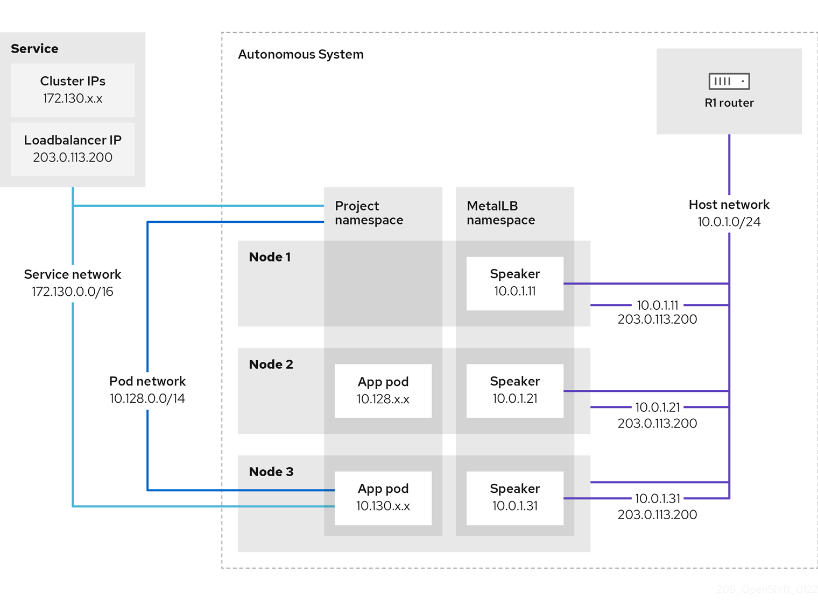

Slide 10
MetalLB and external traffic policy
With layer 2 mode, one node in your cluster receives all the traffic for the service IP address.
With layer 3 mode, a router on the host network opens a connection to one of the nodes in the cluster for a new client connection.
Cluster handles the traffic after it enters the node is affected by the external traffic policy.

Slide 11
External traffic policy
Cluster
  Default
  With the cluster traffic policy, after the node receives the traffic, the service proxy distributes the traffic to all the pods in your service.
  Provides uniform traffic distribution across the pods,
  Obscures the client IP address and it can appear to the application in your pods that the traffic originates from the node rather than the client.
Local
  Service proxy only sends traffic to the pods on the same node traffic receives .
  Pods for the service on additional nodes act as replicas in case failover is needed.
  Application pods can determine the client IP address from the incoming connections.

Slide 12
Limitations for layer 2 mode
  Single-node bottleneck
  No Loadbalancing on node but failover is automatic
  Slow failover performance
Limitations for layer 3 mode
  Node failure can break all active connections
  Support for a single ASN and a single router ID only

